Slide 1
Large Board
Summary of Suggested Changes

Slide 2
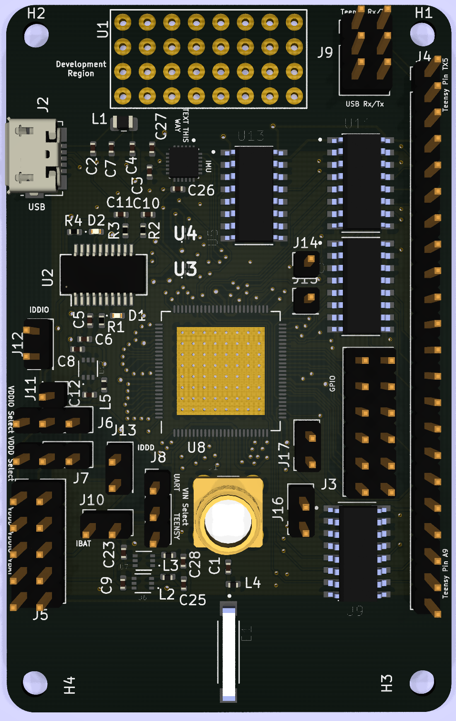
Dimensions
46.1 mm x 72.9 mm
4 holes for M3 screws
Vias for testing
Development Region

Slide 3
Major Components
IMU
ICM-20948
SPI
Level Shifters
Antennas
SMA
Chip
2450AT42B100E
USB

Slide 4
Pin Headers
Teensy
Exterior Voltage sources
VDDD, VDDIO, VBAT, VIN
Boot Source Select
Can tie to VDDD
Current measurement
VDDD, VDDIO, VBAT
VIN Select
Teensy vs USB
VDDD Select
1V vs VBAT
VDDIO Select
1.8V vs VIN vs VBAT
Rx/Tx
USB vs Teensy
Lighthouse
ADC
Input and LDO Output

Slide 5
Changes
No more I2C for IMU
Swapped GPIO12/13 for IMU
Modified scum schematic ALWAYS_ON_LDO
Better labeling
Through-hole antenna
Swap Tx level shifter direction
Lighthouse localization pin headers
Access to ADC pins
External VIN
Current measurement
Changed schematic labels of Teensy header

